Slide 1
Clean Architecture
Notes:
Whos heard of clean architecture?
Hexagonal architecture?

Slide 2
Agenda
What is clean architecture
Layering
Problems that we can solve
What does clean architecture pair well with
Implement it

Slide 3
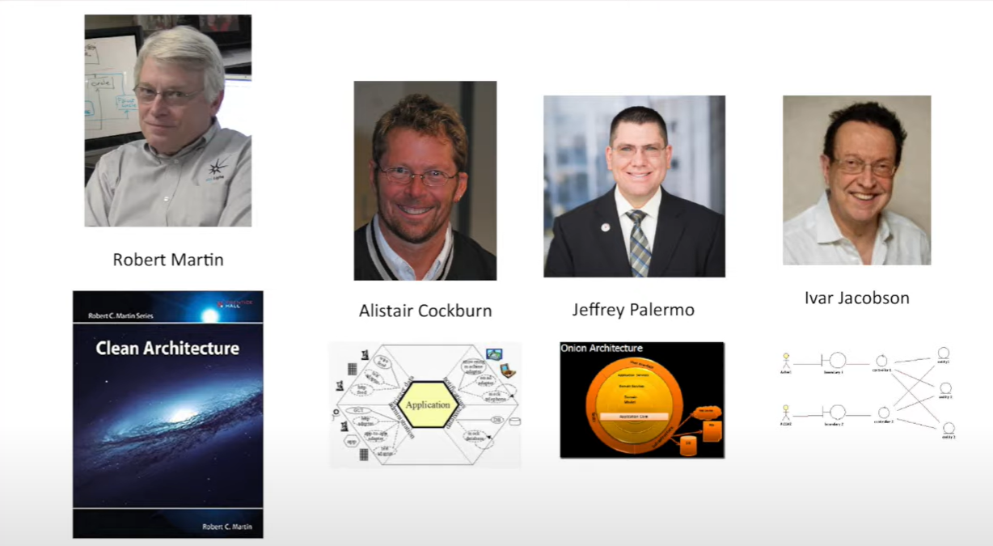
What is the clean architecture
Notes:
Robert Martin coined the term its in his excellent book clean architecture
Alister Cockburn created what he called the hexagonal architecture because his diagram was a hexagon
Jeffrey Palermo Created onion architecture and Ivar jackbson created boundaries controllers and entities
All were talking to the same concerns.

Slide 4
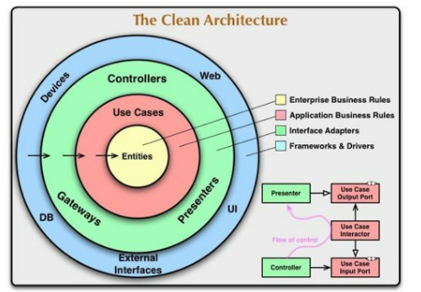
Clean Architecture
A domain centric approach to dependencies

Slide 5
Layering
Notes:
Who here would say they have a layered system
Who would say that is a good thing?

Slide 6
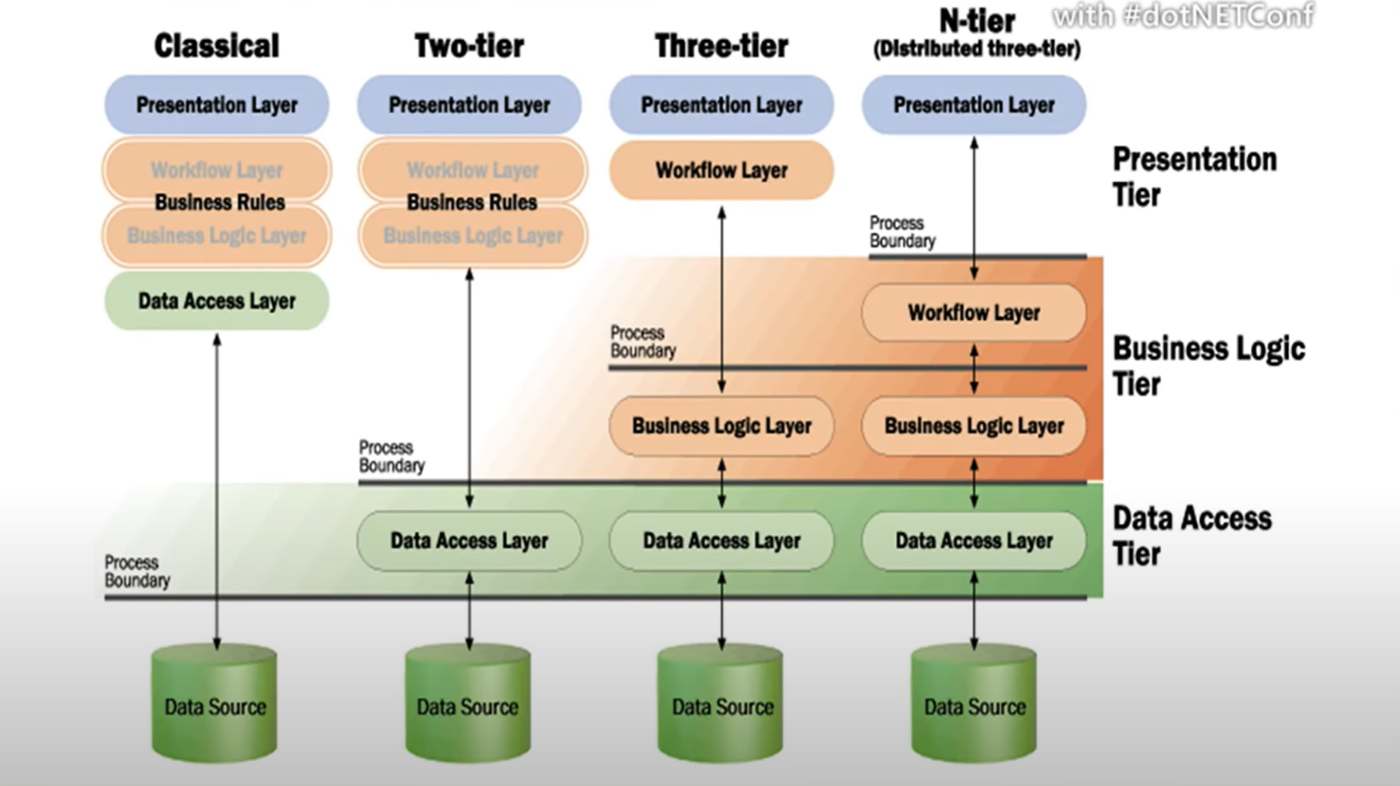
Notes:
Not a new thing this is a Microsoft slide from 2001
Also don’t think that it was ever meant to be 3 layers that is just a convention

Slide 7

Layering
UI
Business
Infrastructure
Database Other INF
Notes:
We separate code into these distinct layers
People often used to call the bottom layer the data layer because it was concerned with the database alone but its really any out of bound dependency, http cache etc
Each layer has a public interface for the layer above.
The calls go down you can't have cycles.

Slide 8
Layering
UI
UI
Infrastructure
Database Other INF
Business
Domain Business
Infrastructure
Database Other INF

Slide 9
Whats good about layers
Don’t worry about implementation details
Swap out implementations in a layer
You can defer decisions about layers to the last minute
Reduce dependencies
Coupling is bad
Coherence is good

Slide 10
Some issues with layering
Models became database we just copied the model up the layers without thinking
Phat services

Slide 11
Layering Changes
UI
A change at the bottom impact every single layer
Code is modeled in layers but not slices
Business
Infrastructure
Random INF

Slide 12
Layering Slides
Feature
Code can be structured in layers, but it should be separated into slices as well.
Phat service
UI
Business
Infrastructure
Random INF

Slide 13
Helpful side features
Mediator (A common interface)
Feature folders

Slide 14
Implementation Issues
Mapping code between layers
Data model to domain to DTO

